Slide 1
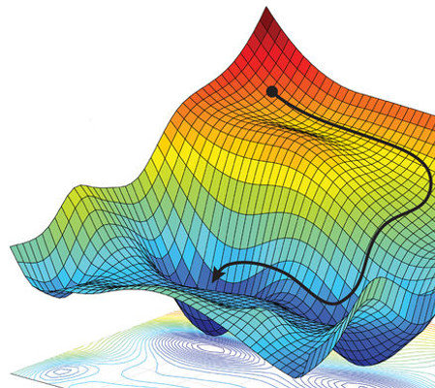
Scale Efficiently
Insights from Pre-Training and Fine-Tuning Transformers
[pdf]

Slide 2
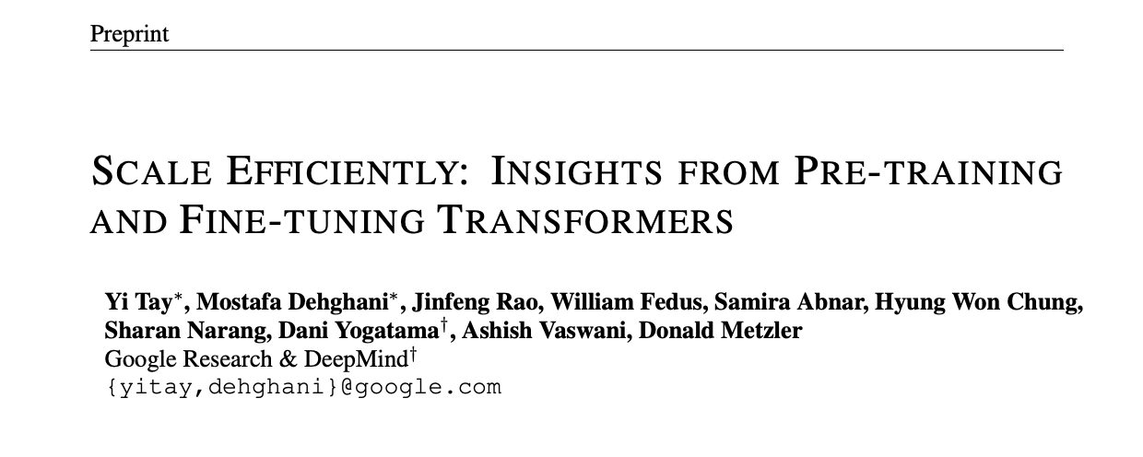
Set-up

Slide 3
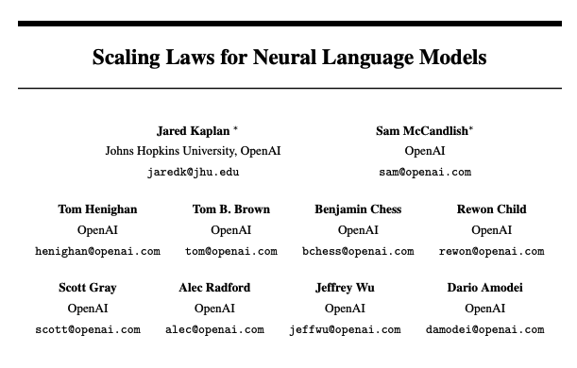
Set-up

Slide 4
Set-up
Kaplan et al, 2020 – exhaustive study of upstream cross-entropy on the language modelling task.
Claim: Performance depends strongly on model size and weakly on model shape.
This Work – exhaustive study on downstream task transfer.
Claim: Downstream task performance depends strongly on model shape.
Notes:
This work confirms the claims of Kaplan et al for model performance on the upstream language modelling task.

Slide 5
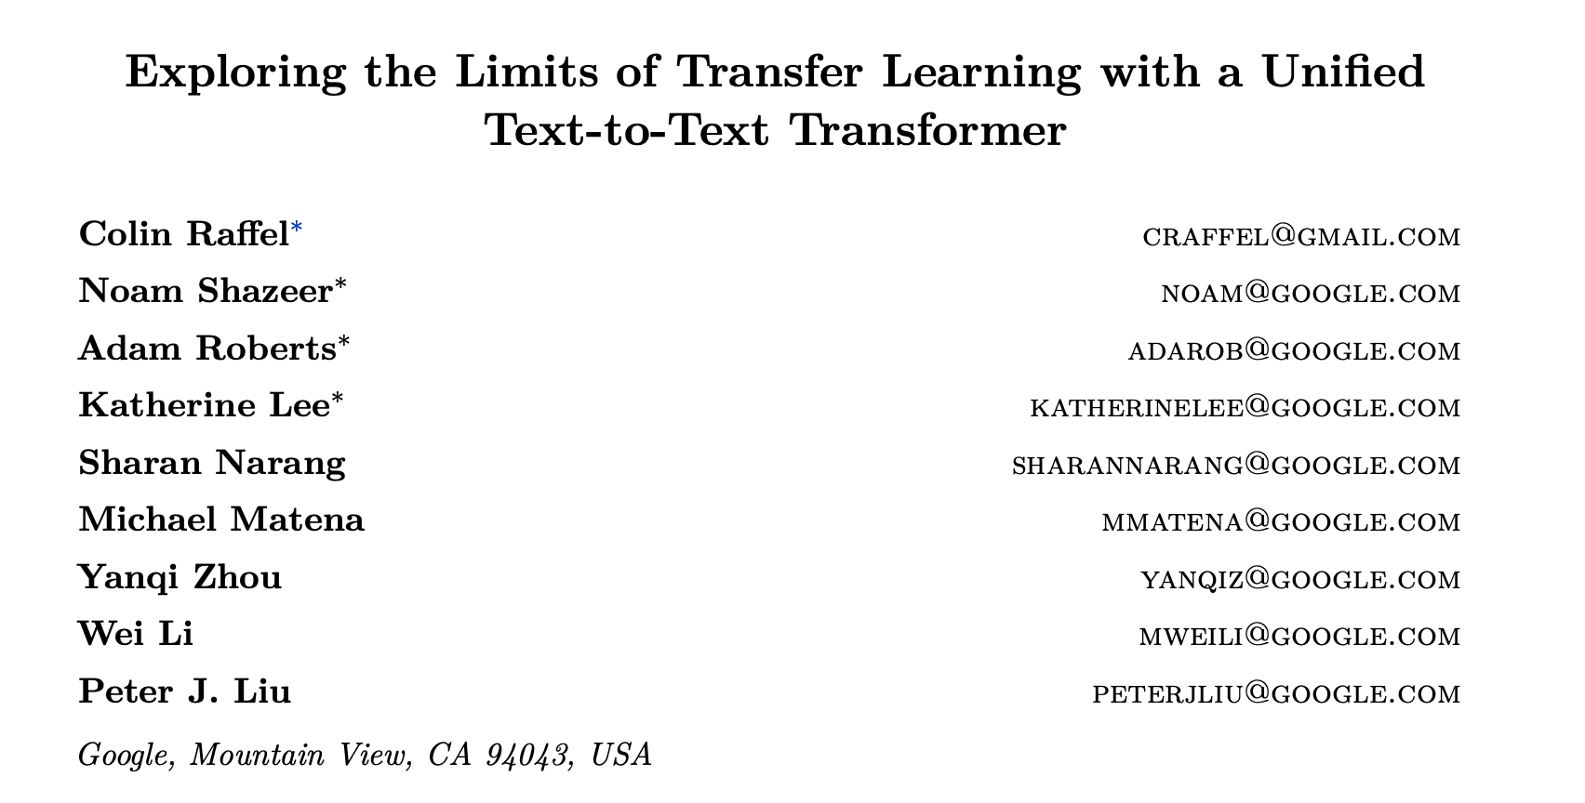
T5 Architecture
Notes:
This work confirms the claims of Kaplan et al for model performance on the upstream language modelling task.

Slide 6
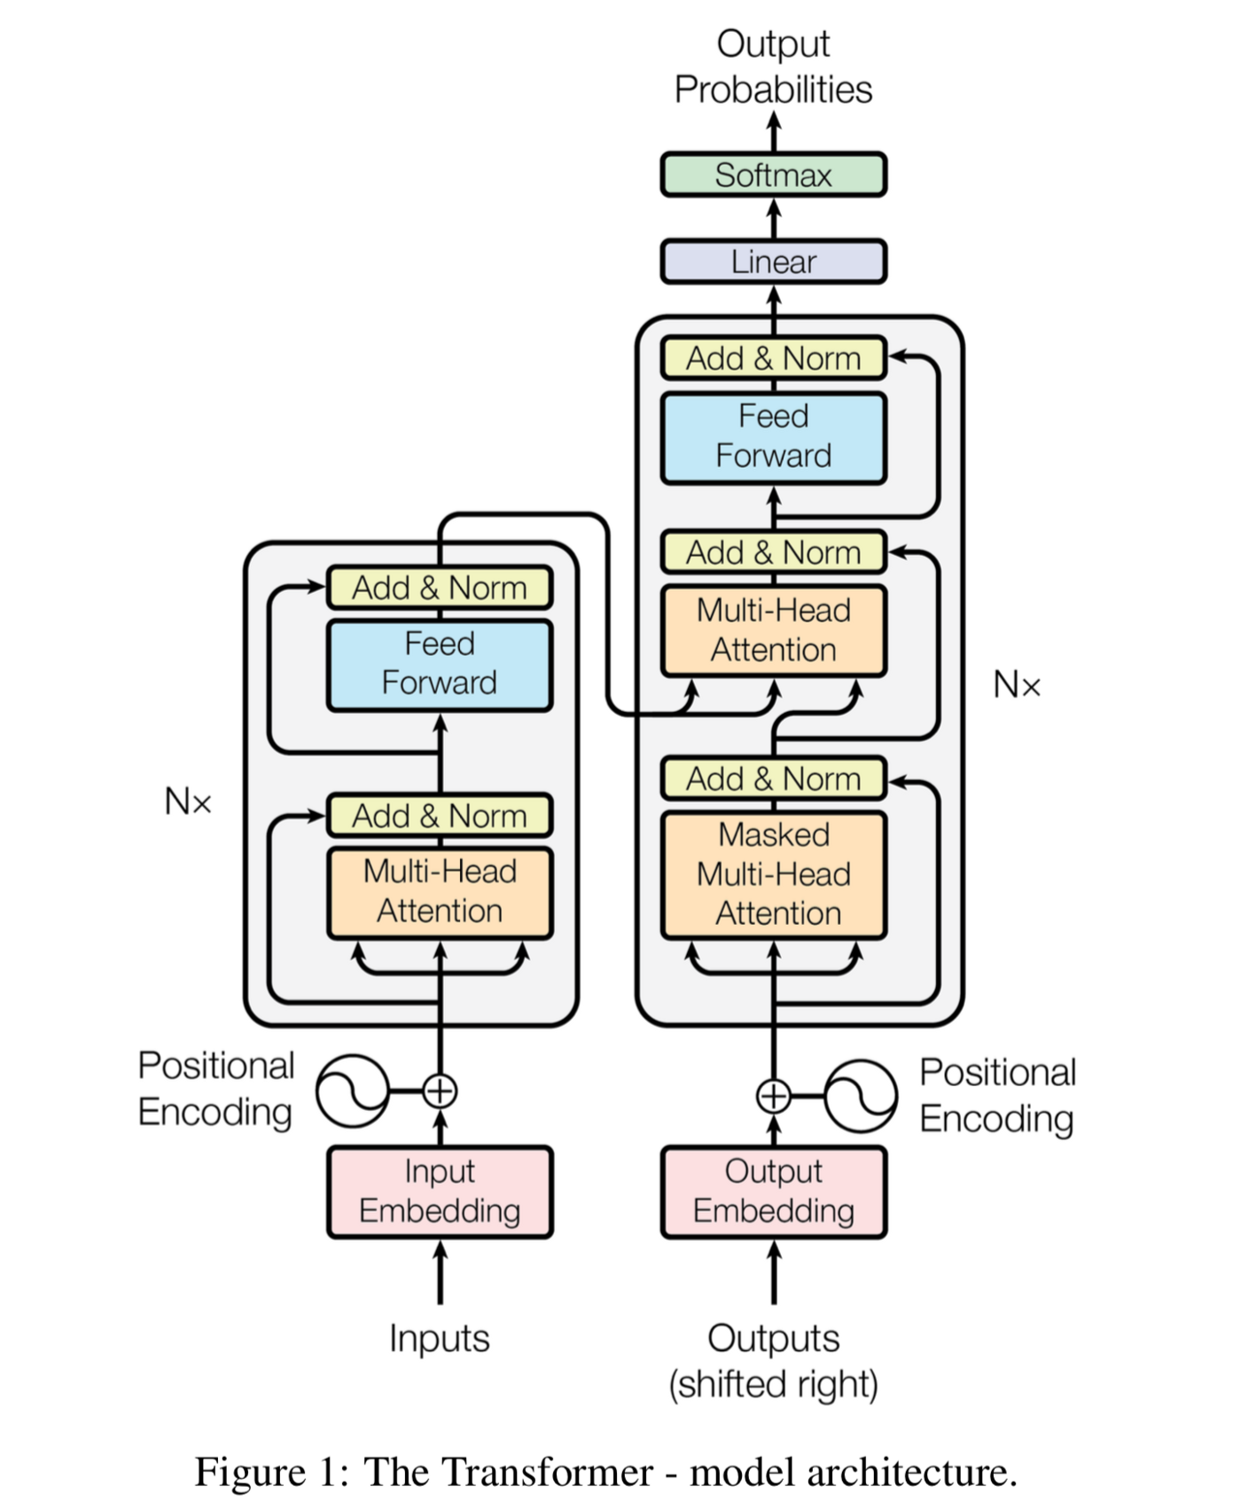
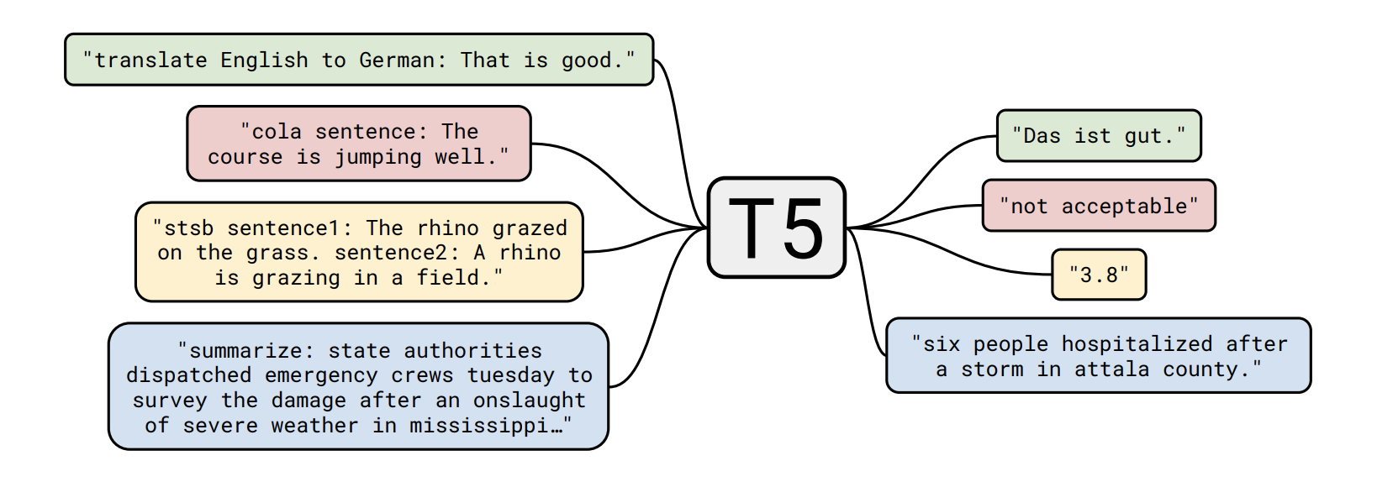
T5 Architecture
Notes:
Basic idea - treat every text-processing problem as a “text-to-text” problem (ie taking text as input and producing new text as output). Use transformer-based encoder-decoder architecture, which largely follows the original form in Vaswani et al.

Slide 7
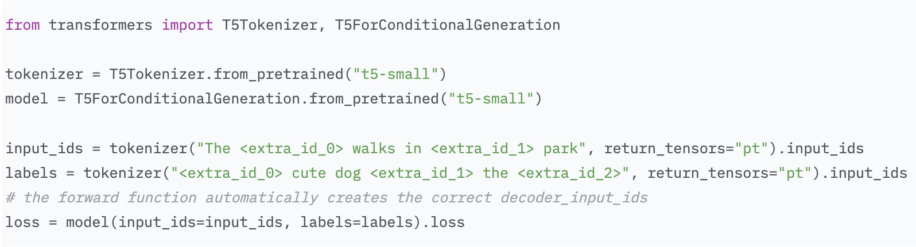
T5 Architecture
Notes:
The objective used to train T5 is not the same autoregressive objective that we see in GPT-3, instead, the objective randomly samples and masks out 15% of the tokens in the input sequence, and the decoder’s job is to predict the sequence of dropped out tokens.

Slide 8
Big Ideas
Key Contributions
Model shape matters for downstream fine-tuning.
Scaling protocols operate differently at different compute regions.
T5-base and T5-large models are Pareto inefficient (shape matters!)
Improved scaling protocols (training smaller, faster models).
Release of over 100 pre-trained T5 configurations!

Slide 9
Big Ideas
Key Contributions
Upstream performance is not correlated with downstream performance.
Scaling protocols operate differently at different compute regions.
T5-base and T5-large models are Pareto inefficient (shape matters!)
Improved scaling protocols (training smaller, faster models).
Release of over 100 pre-trained T5 configurations!

Slide 10
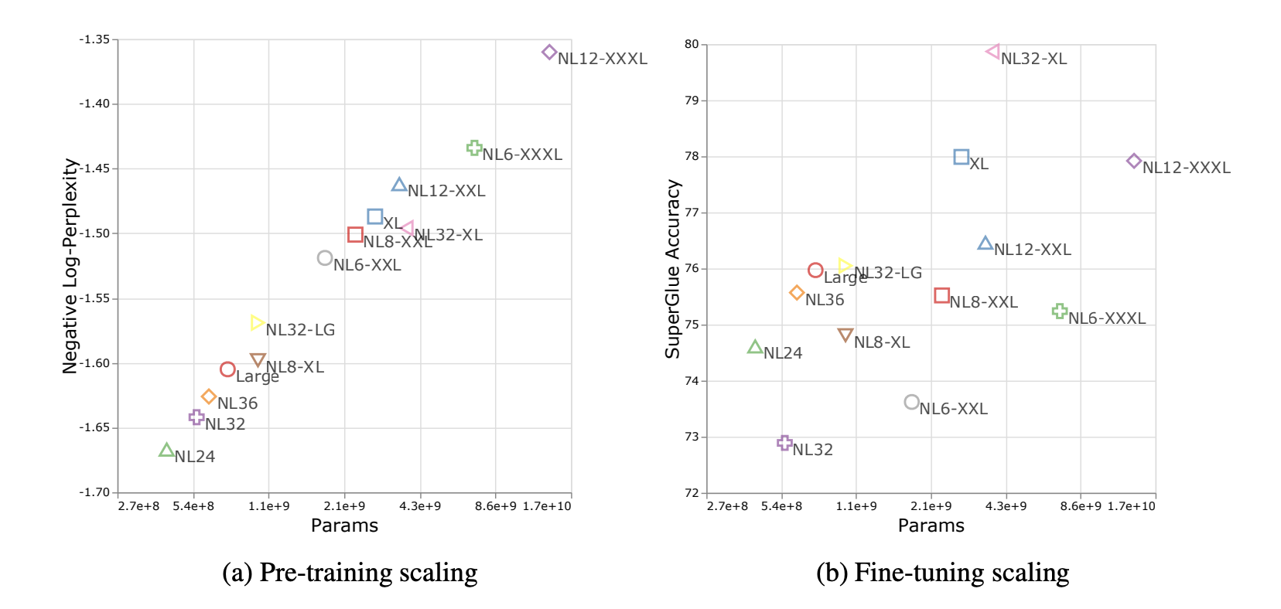
Upstream Perplexity != Downstream Performance
Number of parameters is no longer predictive of model performance when it comes to downstream tasks.
Notes:
A model with improved upstream quality (as measured by validation perplexity) can do significantly worse on transfer is the shape setting is not right.
We can track a couple (three) surprising examples to illustrate this point. [Can click through these quickly]

Slide 11
Upstream Perplexity != Downstream Performance
Number of parameters is no longer predictive of model performance when it comes to downstream tasks.
Notes:
Example 1.

Slide 12
Upstream Perplexity != Downstream Performance
Number of parameters is no longer predictive of model performance when it comes to downstream tasks.
Notes:
Example 2.

Slide 13
Upstream Perplexity != Downstream Performance
Number of parameters is no longer predictive of model performance when it comes to downstream tasks.
Notes:
Example 3.

Slide 14
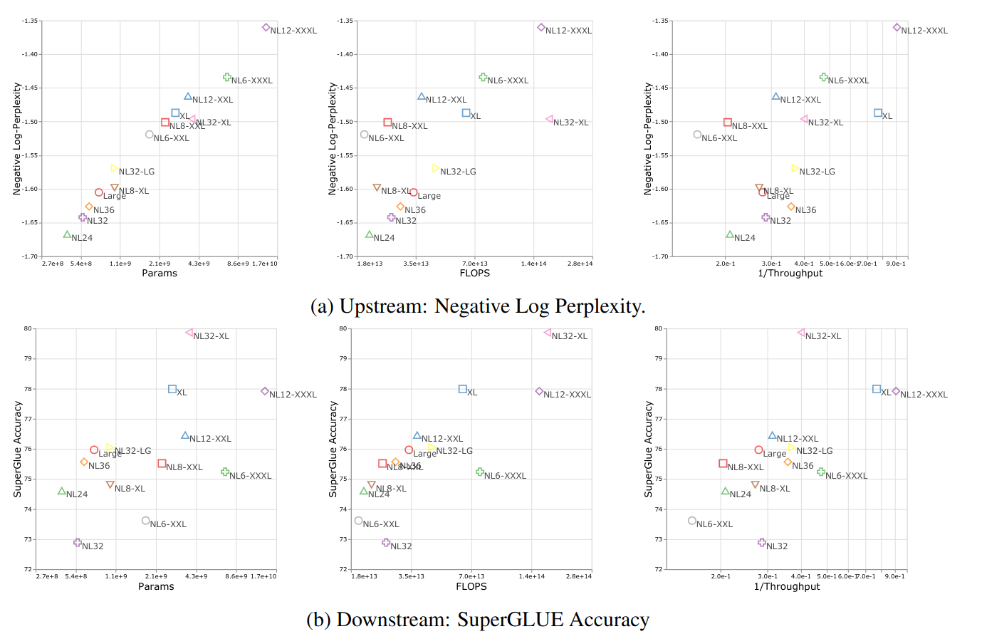
Upstream Perplexity != Downstream Performance
Analysis beyond parameter count
Notes:
Example 3.

Slide 15
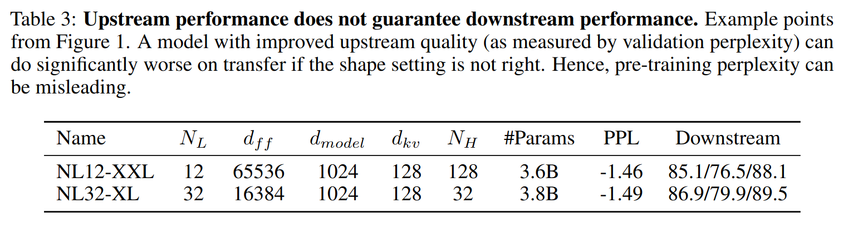
Upstream perplexity != downstream performance.

Slide 16
Upstream perplexity != downstream performance.

Slide 17
Upstream perplexity != downstream performance.

Slide 18
Big Ideas
Key Contributions
Model shape matters for downstream fine-tuning.
Scaling protocols operate differently at different compute regions.
T5-base and T5-large models are Pareto inefficient (shape matters!)
Improved scaling protocols (training smaller, faster models).
Release of over 100 pre-trained T5 configurations!

Slide 19
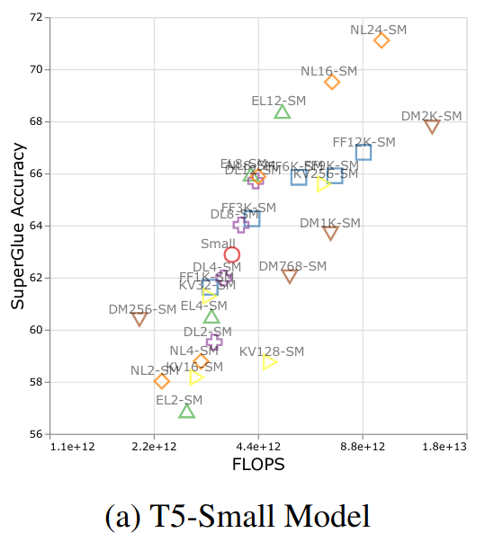
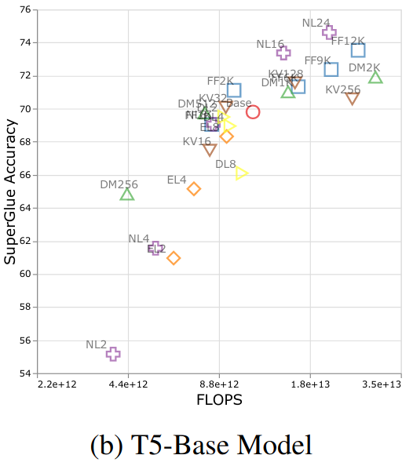
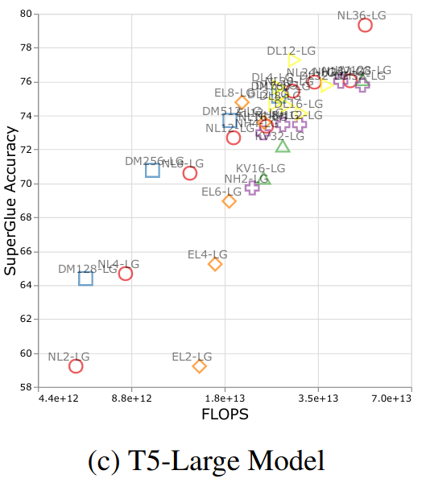
Different Scaling Behaviour Across Compute Regions
“It is clear that the effect of applying different scaling operators is very different across different compute regions.”

Slide 20
Different Scaling Behaviour Across Compute Regions
Model dimension

Slide 21
Different Scaling Behaviour Across Compute Regions
Feed Forward Dimension

Slide 22
Different Scaling Behaviour Across Compute Regions
Number of Layers

Slide 23
Different Scaling Behaviour Across Compute Regions
Number of Encoder Layers

Slide 24
Different Scaling Behaviour Across Compute Regions
Number of Decoder Layers

Slide 25
Big Ideas
Key Contributions
Model shape matters for downstream fine-tuning.
Scaling protocols operate differently at different compute regions.
T5-base and T5-large models are Pareto inefficient.
Improved scaling protocols (training smaller, faster models).
Release of over 100 pre-trained T5 configurations!

Slide 26
T5-base and T5-large models are Pareto inefficient
Better performance for less flops
Notes:
for a given budget (FLOPS), set of parameters on which to spend the budget (NL, d_m, etc...), and a given target performance, there is no way to re-allocate your budget in a way that improves your target performance

Slide 27
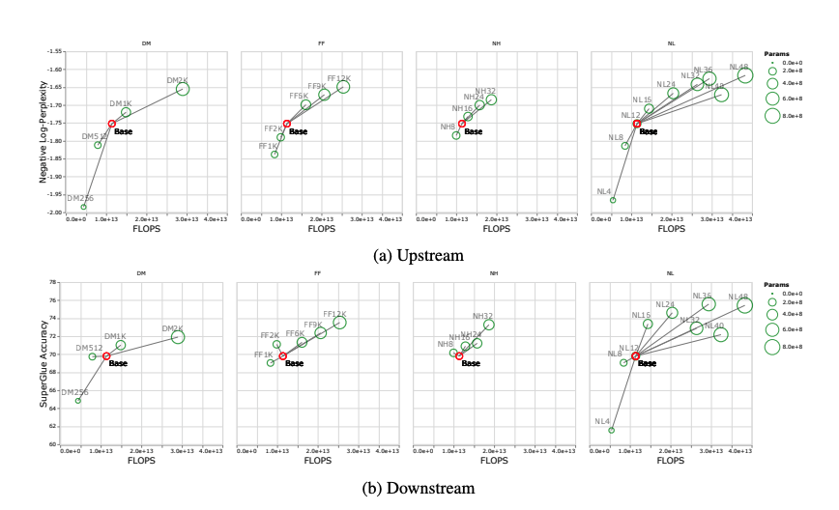
T5-base and T5-large models are Pareto inefficient
Shape matters! Tuning various knobs (DM, FF, NH, NL) yields varying effects on perplexity and performance.

Slide 28
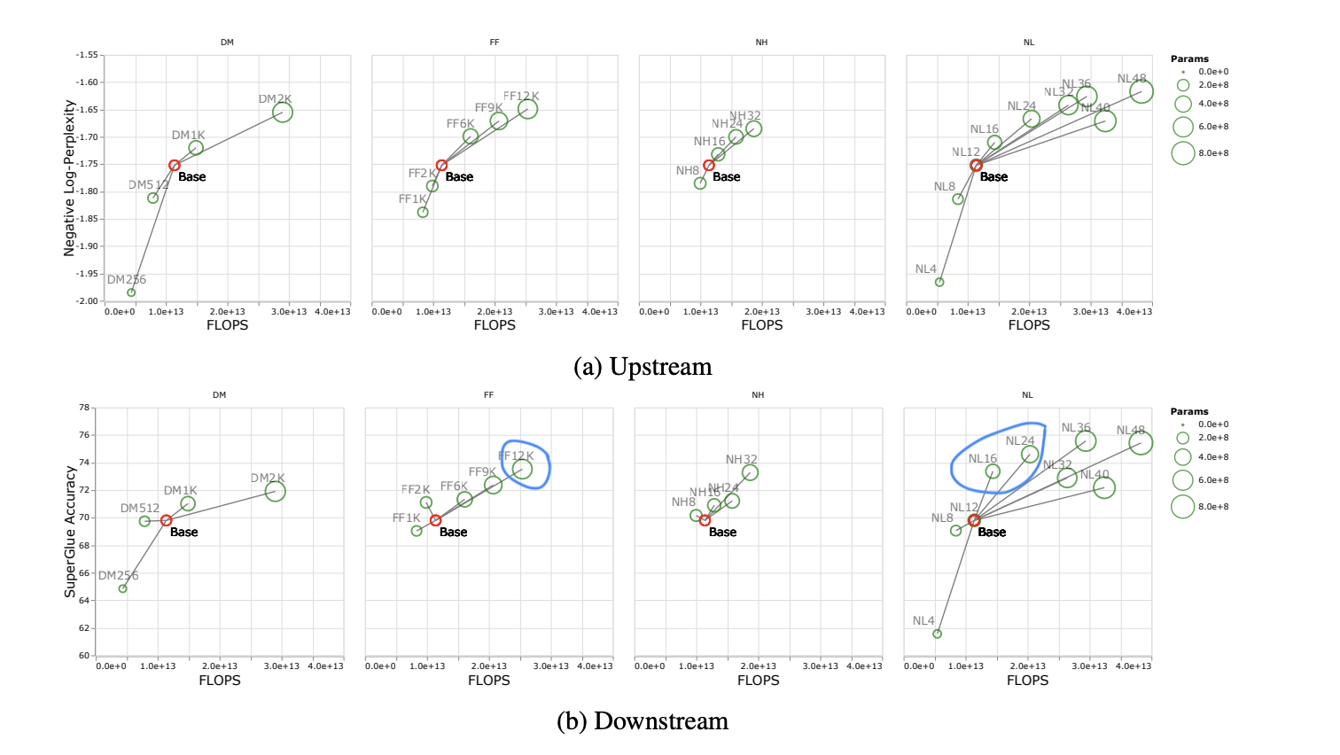
T5-base and T5-large models are Pareto inefficient
Shape matters! Tuning various knobs (DM, FF, NH, NL) yields varying effects on perplexity and performance.

Slide 29
Big Ideas
Key Contributions
Model shape matters for downstream fine-tuning.
Scaling protocols operate differently at different compute regions.
T5-base and T5-large models are Pareto inefficient.
Improved scaling protocols (training smaller, faster models).
Release of over 100 pre-trained T5 configurations!

Slide 30
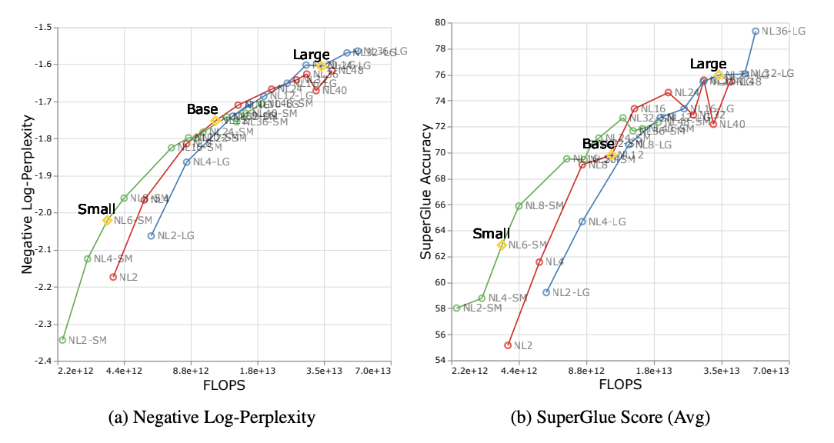
Scaling Recommendation - The DeepNarrow Strategy
Idea: If you’re wanting to scale your model, scale model depth first.

Slide 31
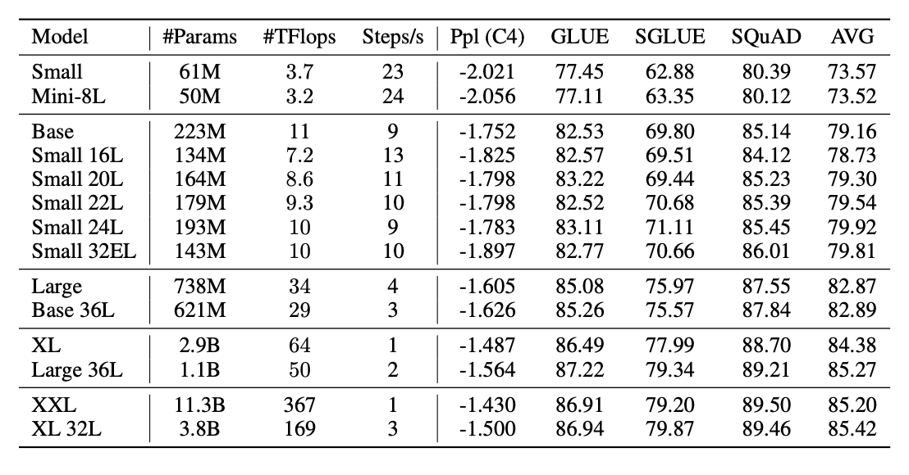
Scaling Recommendation - The DeepNarrow Strategy
Idea: If you’re wanting to scale your model, scale model depth first.

Slide 32
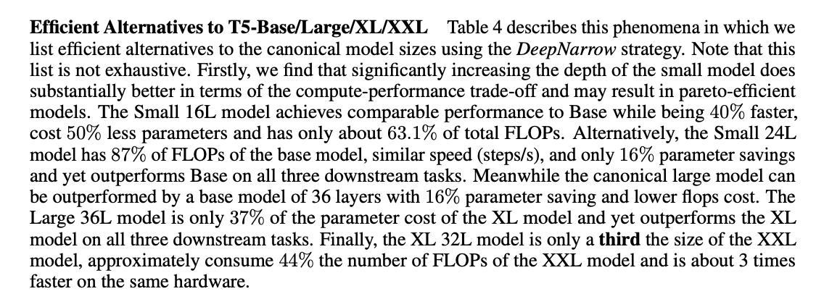
Scaling Recommendation - The DeepNarrow Strategy
Idea: If you’re wanting to scale your model, scale model depth first.

Slide 33
Big Ideas
Key Contributions
Model shape matters for downstream fine-tuning.
Scaling protocols operate differently at different compute regions.
T5-base and T5-large models are Pareto inefficient (shape matters!)
Improved scaling protocols (training smaller, faster models).
Release of over 100 pre-trained T5 configurations!

Slide 34
Release of over 100 pre-trained T5 configurations!
Link to HuggingFace open issue with checkpoint link and discussion.

Slide 35
Discussion

Slide 36
Depth vs. Width

Slide 37
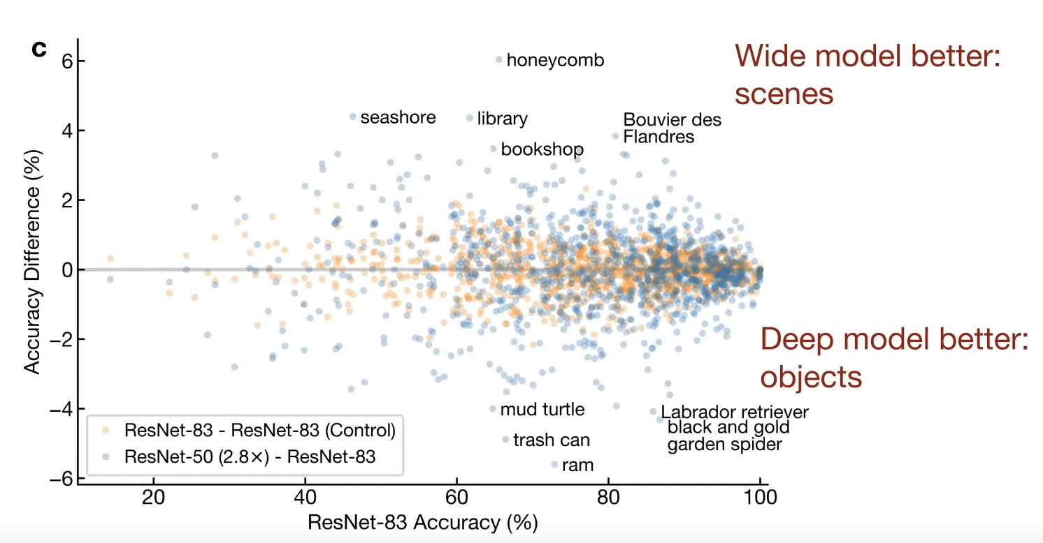
Are wide models better than deep models?
Source: https://arxiv.org/abs/2010.15327
Interesting observation for CV, but not clear if there is a parallel for language
Notes:
https://youtu.be/6uPop547u_E?t=1507

Slide 38
Optimal depth/width ratios

Slide 39
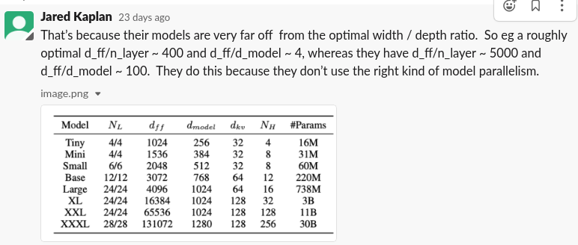

Slide 40
Variance in finetuning

Slide 41
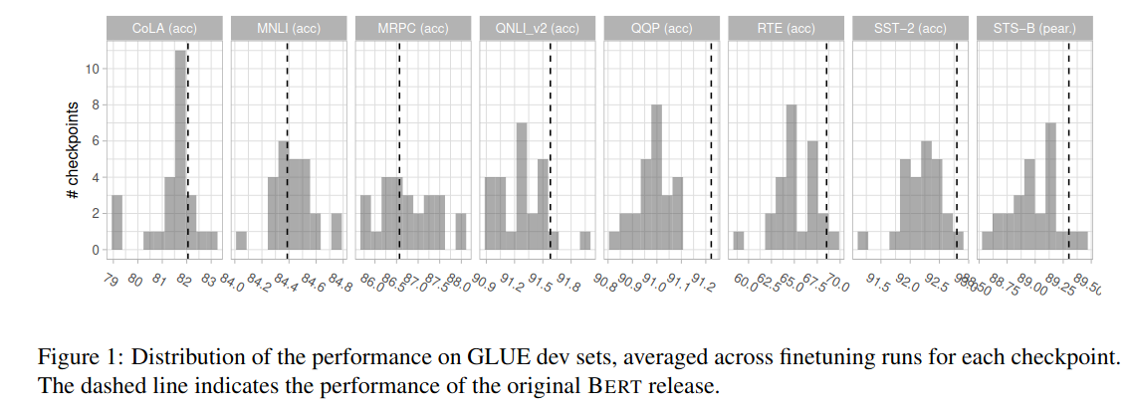
Variance across pretraining seeds
Source: https://arxiv.org/abs/2106.16163
Pretraining with different seeds can lead to large differences in downstream performance

Slide 42
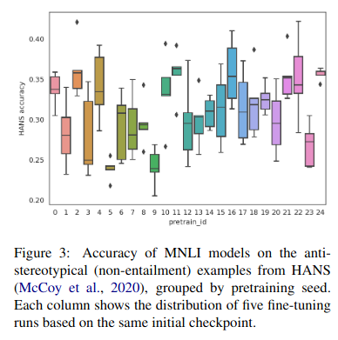
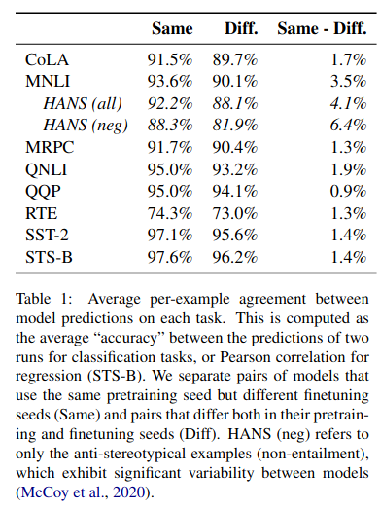
Variance across pretraining and finetuning seeds
Source: https://arxiv.org/abs/2106.16163
Finetuning with different seeds also leads to large differences in downstream performance

Slide 43
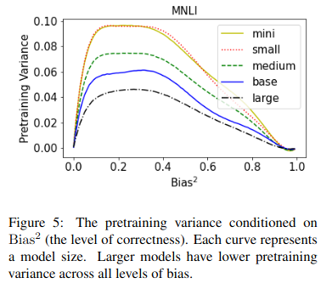
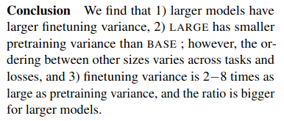
Instability as a function of model scale
Source: https://arxiv.org/abs/2105.06020

Slide 44
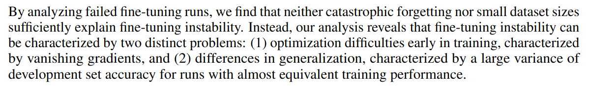
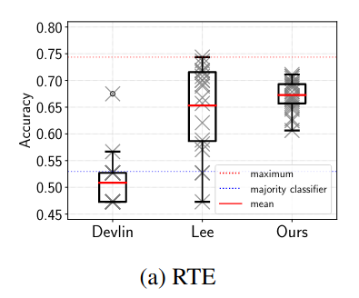
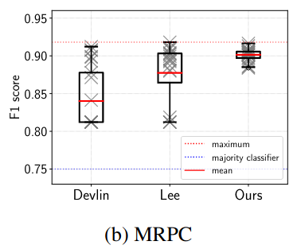
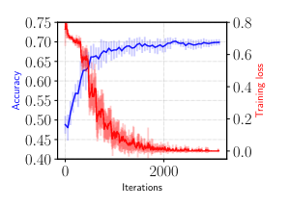
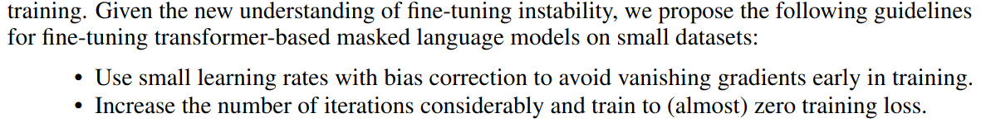
Explaining finetuning instability
Source: https://arxiv.org/abs/2006.04884

Slide 45
Pretrain-finetune paradigm

Slide 46
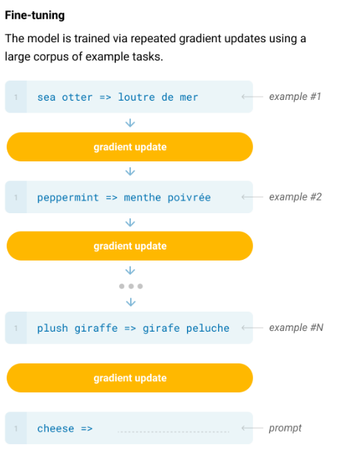
Downstream is Dead
Pretrain-finetune evaluation becomes less and less reliable with larger models
“The potential to exploit spurious correlations in training data fundamentally grows with the expressiveness of the model and the narrowness of the training distribution. [...] Models are designed to be large to absorb information during pre-training, but are then fine-tuned on very narrow task distributions”
GPT-3
Poor OOD generalization [1] Spurious feature exploitation [2] [3];

Slide 47
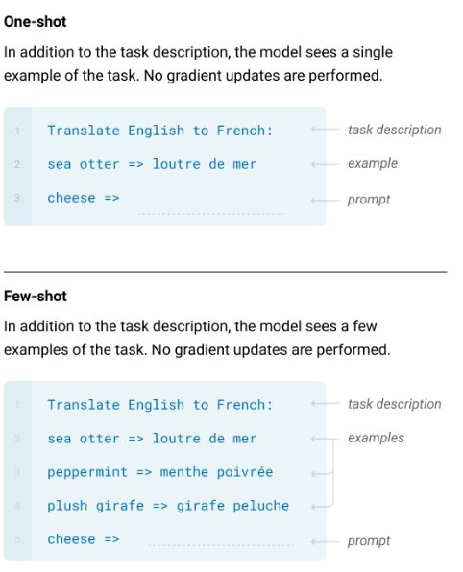
Downstream is Dead, Long Live Downstream
In-context learning (allegedly) removes these confounds

Slide 48
Downstream is Dead, Long Live Downstream
In-context learning (allegedly) removes these confounds
“The potential to exploit spurious correlations in in-context prompts fundamentally grows with the expressiveness of the model and the narrowness of the prompt distribution. [...] Models are designed to be large to absorb information during pre-training, but are then frozen and unable to learn anything new.”
Me

Slide 49
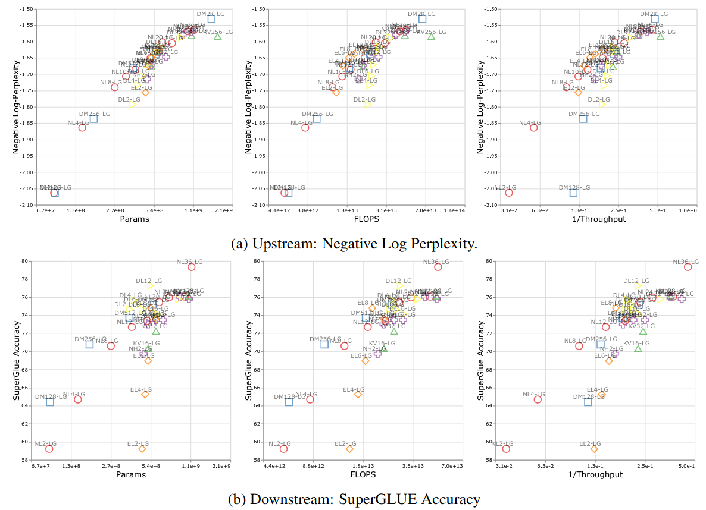
Pretrained Models: Agents or Feature Extractors?
Scaling encoder (feature extractor) vs decoder (agent) layers

Slide 50
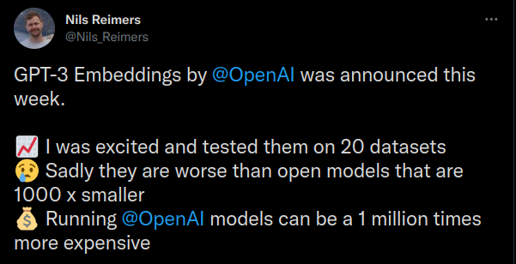
Pretrained Models: Agents or Feature Extractors?
Are there limits to the “agent” approach? Or can we frame everything as a decoding task?

Slide 51
Pretrained Models: Agents or Feature Extractors?
What would a GPT model trained on all of youtube look like as an agent?

